Slide 1
Bayesian linear modelling for ecology and evolution in R
glm to MCMCglmm

Slide 2
Bayesian linear modelling for ecology and evolution in R
glm to MCMCglmm

Slide 3
Bayesian linear modelling for ecology and evolution in R
glm to MCMCglmm

Slide 4
Generalized Linear model
y
y = Xβ + e
e = residual error
β₀
β₁
x₁

Slide 5
Bayesian linear modelling for ecology and evolution in R
glm to MCMCglmm

Slide 6
Bayesian linear modelling for ecology and evolution in R
glm to MCMCglmm

Slide 7
Generlized Linear model
y = Xβ + Zu + e
Zu = random effect
y
Zu
x₁

Slide 8
Bayesian linear modelling for ecology and evolution in R
glm to MCMCglmm

Slide 9
Bayesian linear modelling for ecology and evolution in R
glm to MCMCglmm

Slide 10
Bayesian
Thomas Bayes
1702-61

Slide 11

Bayesian
?
Thomas Bayes
1702-61

Slide 12
Bayes Theorem
P(E|H)
P(H)
P(H|E)
=
P(E)

Slide 13
Probability of
H given E
P(E|H)
P(H)
P(H|E)
=
P(E)

Slide 14
Posterior
probability
P(E|H)
P(H)
P(H|E)
=
P(E)

Slide 15
The Likelihood
P(E|H)
P(H)
P(H|E)
=
P(E)

Slide 16
The Prior
P(H)
P(E|H)
P(H|E)
=
P(E)

Slide 17
P(E|H)
P(H)
P(H|E)
=
P(E)
The probability of E over all possibilities

Slide 18
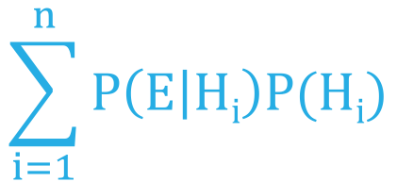
P (E|H)
P (H)
P (H|E)
=
$$\sum_{i=1}^{n}{P\left(E | Hi\right)P(Hi)}$$
The probability of E over all possibilities

Slide 19
Lucky for us we can forget the bottom and use
P(H|E)
P(E|H)
P(H)
~

Slide 20
Bayesian linear modelling for ecology and evolution in R
glm to MCMCglmm

Slide 21
Bayesian linear modelling for ecology and evolution in R
glm to MCMCglmm

Slide 22
glm to Monte CarloMCglmm

Slide 23

glm to Monte CarloMCglmm

Slide 24
Bayesian linear modelling for ecology and evolution in R
glm to MCMCglmm

Slide 25
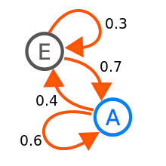
glm to MCMarkov Chainglmm

Slide 26
Monte Carlo Markov Chain
y = Xβ + Zu + e

Slide 27


Monte Carlo Markov Chain
y = Xβ + Zu + e

Slide 28


Monte Carlo Markov Chain
X₀
y = Xβ + Zu + e

Slide 29
Monte Carlo Markov Chain
X₀
y = Xβ + Zu + e

Slide 30
Monte Carlo Markov Chain
X₀
X_{t}
y = Xβ + Zu + e

Slide 31
P(H|E)
P(E|H)
P(H)
~

Slide 32
Monte Carlo Markov Chain
X₀
X_{t}
y = Xβ + Zu + e
P(E|X_{t})
P(X_{t})
P(E|X₀)
P(X_{o})

Slide 33
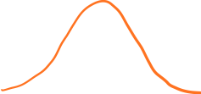
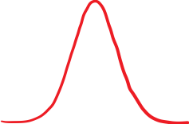

Priors
y = Xβ + Zu + e

Slide 34


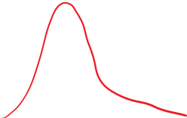
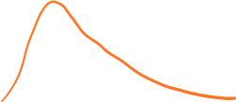
Priors
y = Xβ + Zu + e

Slide 35
Monte Carlo Markov Chain
X₀
X_{t}
y = Xβ + Zu + e
P(E|X_{t})
P(X_{t})
P(E|X₀)
P(X_{o})

Slide 36
Monte Carlo Markov Chain
X₀
X_{t}
y = Xβ + Zu + e
P(E|X_{t})
P(X_{t})
P(E|X₀)
P(X_{o})

Slide 37

Monte Carlo Markov Chain
X₀
X_{t}
y = Xβ + Zu + e
P(E|X_{t})
P(X_{t})
P(E|X₀)
P(X_{o})
>1
X_{t}

Slide 38
Monte Carlo Markov Chain
X₀
X_{t}
y = Xβ + Zu + e
P(E|X_{t})
P(X_{t})
P(E|X₀)
P(X_{o})
<1
Go to X_{t}
with the probability
P(E|X_{t})
P(X_{t})
P(E|X₀)
P(X_{o})

Slide 39



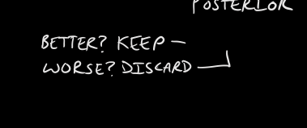
Monte Carlo Markov Chain
X₀
X_{t}
y = Xβ + Zu + e
P(E|X₀)
P(X₀)
P(E|X_{t})
P(X_{t})
P(E|X_{t1})
P(X_{t1})
P(E|X_{tx})
P(X_{tx})

Slide 40
Monte Carlo Markov Chain
X₀
X_{t}
y = Xβ + Zu + e
P(E|X₀)
P(X₀)
P(E|X_{t})
P(X_{t})
P(E|X_{t1})
P(X_{t1})
P(E|X_{tx})
P(X_{tx})

Slide 41
Remember this guy
P (E|H)
P (H)
P (H|E)
=
$$\sum_{i=1}^{n}{P\left(E | Hi\right)P(Hi)}$$
The probability of E over all possibilities

Slide 42
P (X_{t}|E)
=
P (X₀|E)

Slide 43
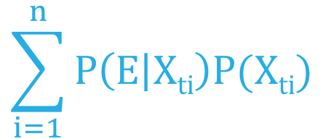
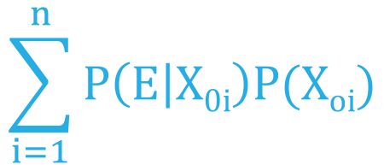
P (E|X_{t})
P (X_{t})
$$\sum_{i=1}^{n}{P\left(E | Xti\right)P(Xti)}$$
P (X_{t}|E)
=
=
P (X₀|E)
P (E|X₀)
P (X₀)
$$\sum_{i=1}^{n}{P\left(E | X0i\right)P(Xoi)}$$

Slide 44
P (E|X_{t})
P (X_{t})
$$\sum_{i=1}^{n}{P\left(E | Xti\right)P(Xti)}$$
P (X_{t}|E)
=
=
P(E|X_{t})
P(X_{t})
P (X₀|E)
P(E|X₀)
P(X_{o})
P (E|X₀)
P (X₀)
$$\sum_{i=1}^{n}{P\left(E | X0i\right)P(Xoi)}$$

Slide 45
Monte Carlo Markov Chain
X₀
X_{t}
y = Xβ + Zu + e
P(X_{t})
Posterior X_{t}
Posterior X₀
P
Posterior X_{t2}
Posterior X_{t1}

Slide 46
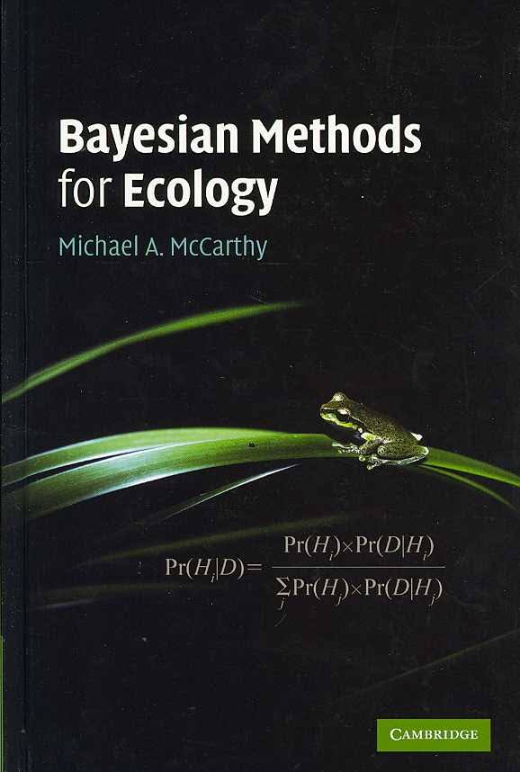

Slide 47
Lets do some examples

Slide 48

We ran into the problem of non-independent data.
y
x₁

Slide 49
Kingdom Phyla Class Order Family Genus Species Population individual

Slide 50
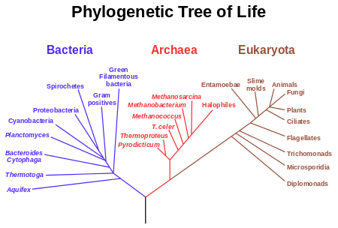

Slide 51
Nested
y
Red points more related to each other than all other points but two groups also within red.
x₁

Slide 52

Build a phylogeny

Slide 53
Speciation
Present

Slide 54
Assume evolution is a Brownian walk
Speciation
Present

Slide 55
Assume evolution is a Brownian walk
Traits evolution
Present

Slide 56
Use distance on phylogeny
y
x₁

Slide 57
Use distance on phylogeny
y
x₁

Slide 58
Variance co-variance matrix
10
10
10
10

Slide 59
Variance co-variance matrix
4
10
4
4
10
10

Slide 60
Variance co-variance matrix
2
10
4
2
4
10
2
2
2
10

Slide 61
Assume Brownian motion
y = Xβ + Zu + e
Zu is now a VCV
10
4
2
4
10
2
2
2
10

Slide 62
Pagels lambda
10
4
2
X λ
4
10
2
2
2
10

Slide 63
Pagels lambda
λ = 1
10
4
2
X 1
4
10
2
2
2
10

Slide 64
Pagels lambda
λ = 0
0
0
0
X 0
0
0
0
0
0
0

